Slide 1
Web Development using React js
Sharmake Ali Kahie
Lecturer
Faculty of Computer & IT
Jamahiriya University of Science & Technology
kahie@just.edu.so

Slide 2
Chapter #6
Bootstrap
useReducer
useRef
React Router
useContext
Bootstrap

Slide 3
Bootstrap
Bootstrap is a free front-end framework for faster and easier web development
Bootstrap includes HTML and CSS based design templates for typography, forms, buttons, tables, navigation, modals, image carousels and many other, as well as optional JavaScript plugins
Bootstrap also gives you the ability to easily create responsive designs

Slide 4
Bootstrap
Bootstrap is the most popular HTML, CSS, and JavaScript framework for developing responsive, mobile-first websites
Now that Bootstrap 5 no longer requires jQuery, using it in your React app is much easier and without conflicts Now that Bootstrap 5 components are written as vanilla JS plugins, you get improved alignment with React's best patterns & practices.
This also means it's possible to use Bootstrap 5 components without the need for a 3rd party library like react-bootstrap or reactstrap

Slide 5
Method to Add Bootstrap to React
First up, add Bootstrap to your React app's package.json
npm install bootstrap –save
There are mainly three ways to add Bootstrap to the React app. We will discuss them one by one.
Using Bootstrap CDN.
Import Bootstrap in React as a dependency
Install React Bootstrap package (such as bootstrap-react or reactstrap)

Slide 6
Bootstrap CDN
This is one of the easiest ways to use bootstrap in your React app. The best thing about bootstrap CDN is no requirement for installation or downloads. You just need to copy and paste a link in the head section of your app to make it work. Below is the link that you need.
<link rel="stylesheet" href="https://stackpath.bootstrapcdn.com/bootstrap/4.1.0/css/bootstrap.min.css" integrity="sha384-9gVQ4dYFwwWSjIDZnLEWnxCjeSWFphJiwGPXr1jddIhOegiu1FwO5qRGvFXOdJZ4" crossorigin="anonymous">

Slide 7
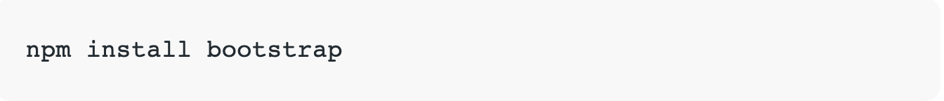
Import Bootstrap as a Dependency
You might have used some module bundler or webpack in your application or you might have heard these names. This one is another option to add bootstrap to your React application. You can run the command given below and install bootstrap as a dependency in your application.

Slide 8
Import Bootstrap as a Dependency
You might have used some module bundler or webpack in your application or you might have heard these names. This one is another option to add bootstrap to your React application. You can run the command given below and install bootstrap as a dependency in your application.

Slide 9
Install React Bootstrap Package
The other method to add bootstrap in your React component is adding a package with the inbuilt bootstrap component. These are designed to work with your React application components. Below is the name of two popular packages.
react-bootstrap
Reactstrap
Both are good choices for using Bootstrap with React apps
npm install react-bootstrap bootstrap

Slide 10
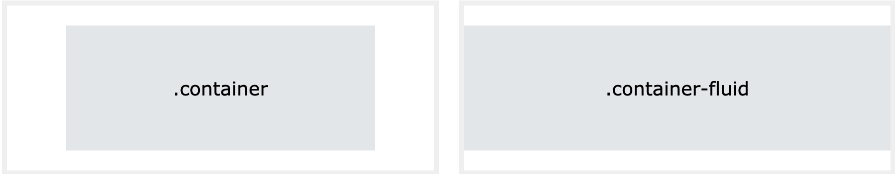
Bootstrap 5 Containers
Containers are used to pad the content inside of them, and there are two container classes available:
The .container class provides a responsive fixed width container
The .container-fluid class provides a full-width container, spanning the entire width of the viewport

Slide 11
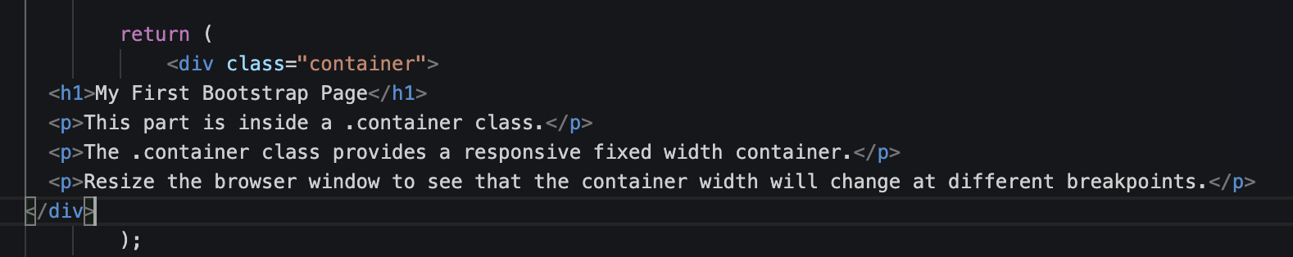
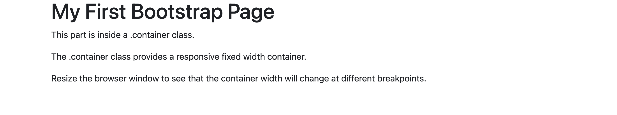
Bootstrap 5 Containers

Slide 12
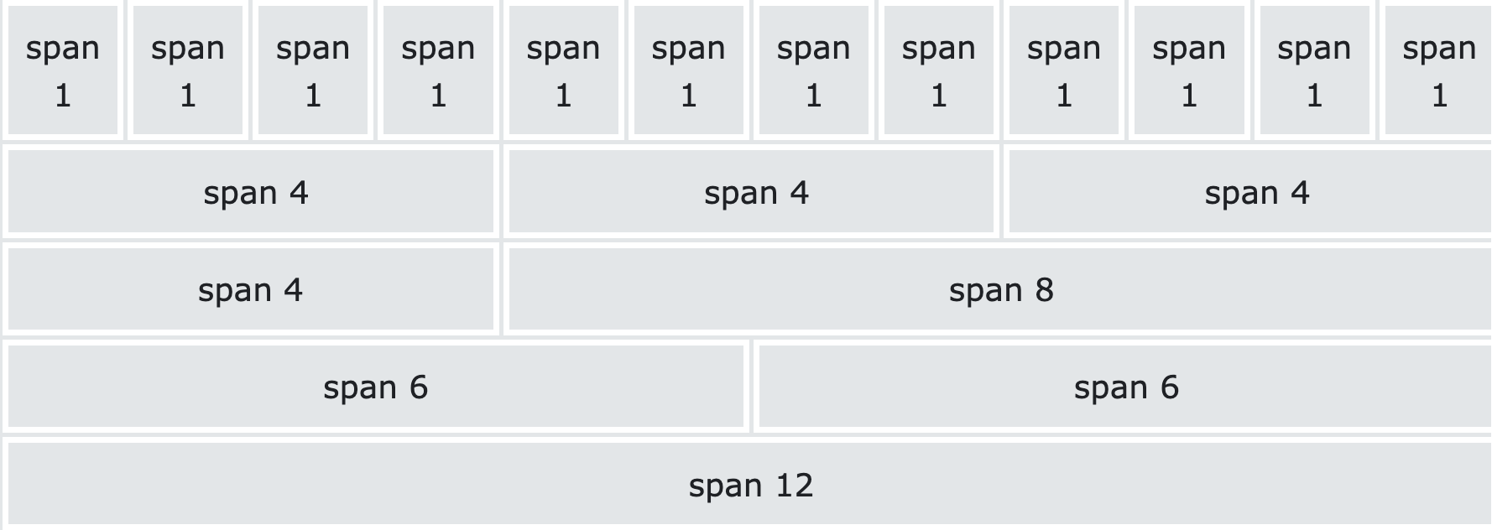
Bootstrap 5 Grid System
Bootstrap's grid system is built with flexbox and allows up to 12 columns across the page.
If you do not want to use all 12 columns individually, you can group the columns together to create wider columns
The grid system is responsive, and the columns will re-arrange automatically depending on the screen size.
Make sure that the sum adds up to 12 or fewer (it is not required that you use all 12 available columns)

Slide 13
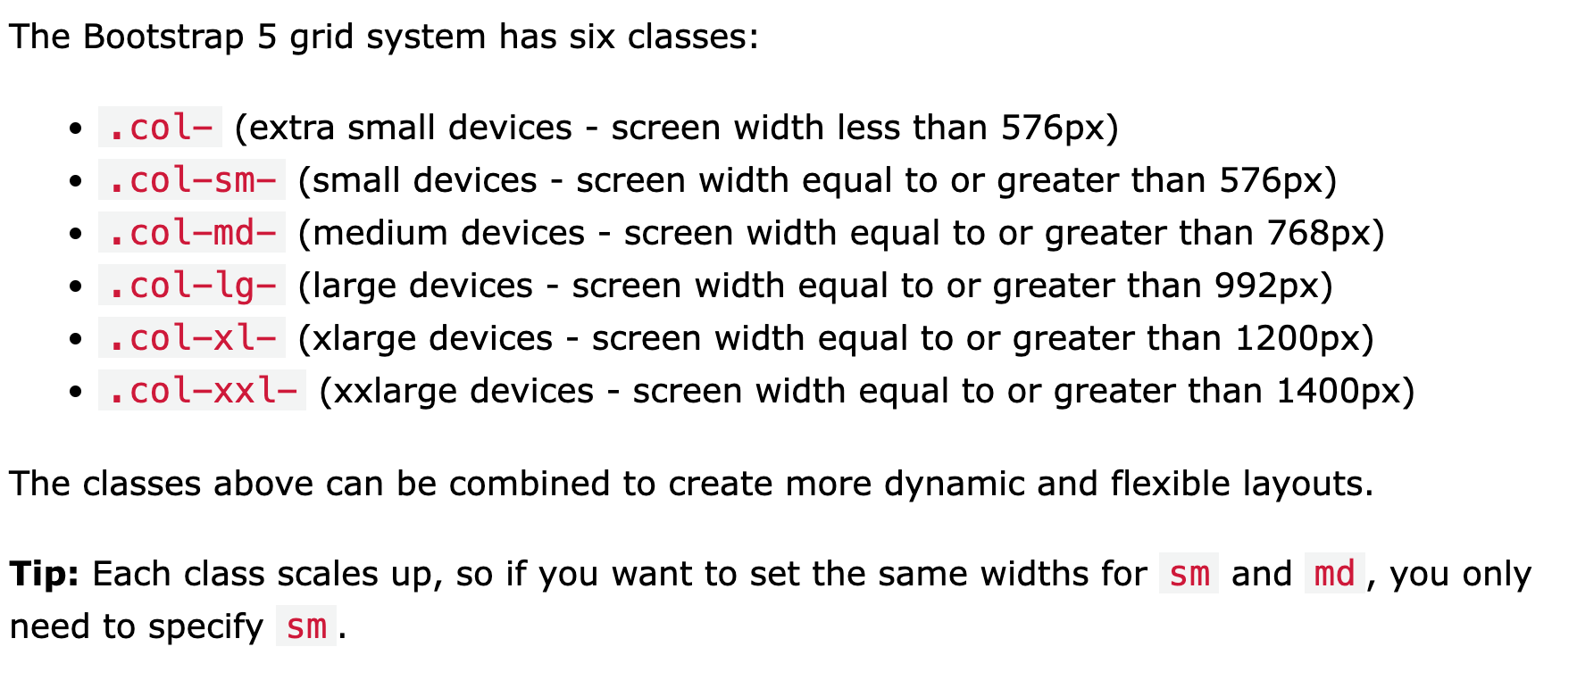
Grid Classes

Slide 14
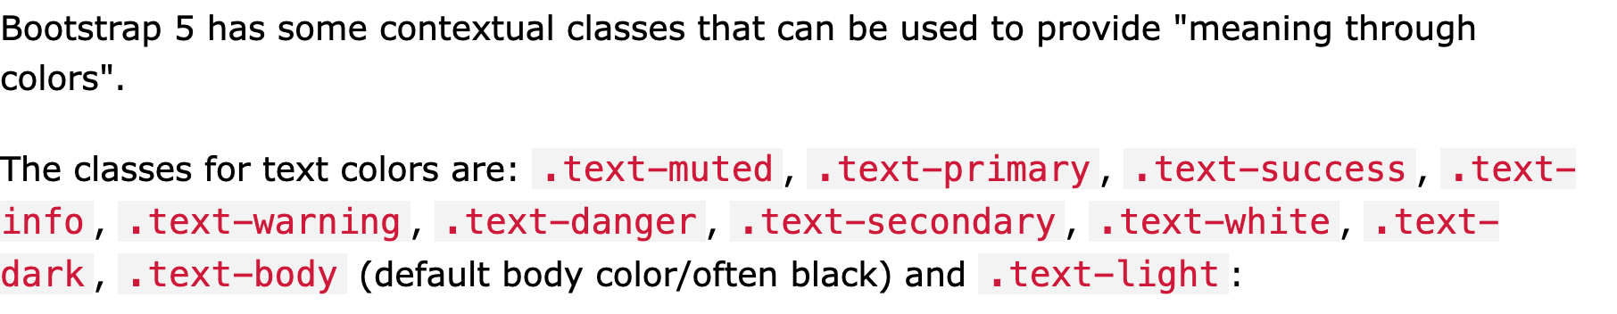
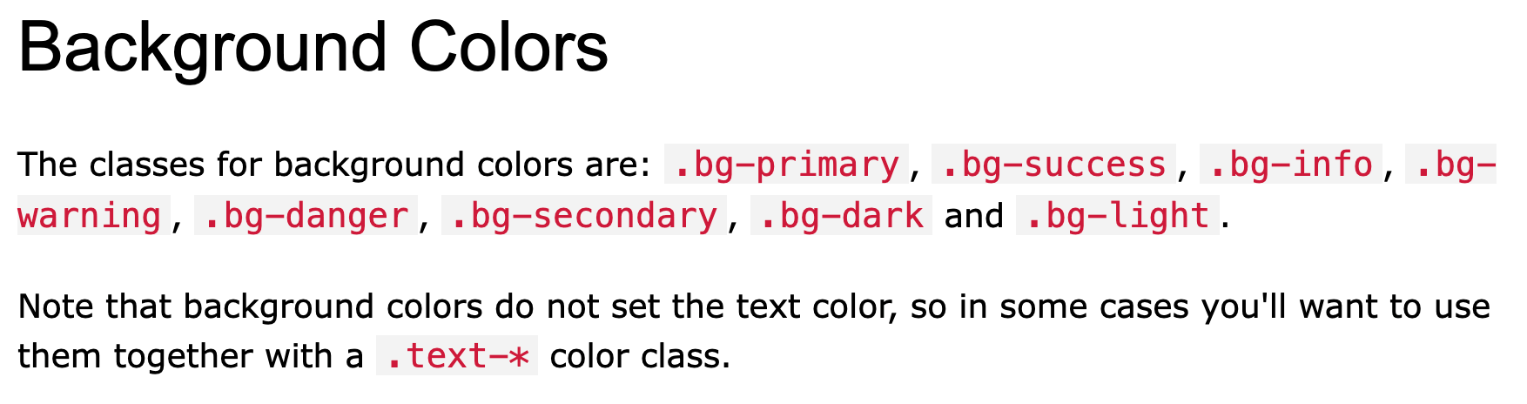
Bootstrap 5 Colors

Slide 15
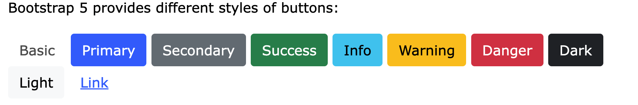
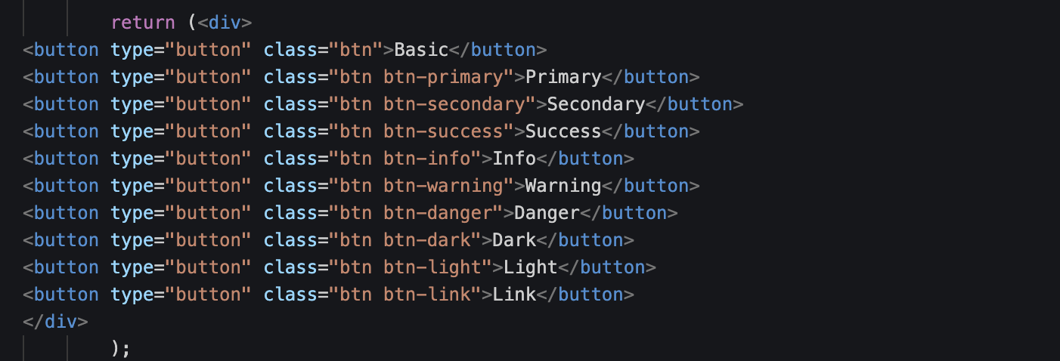
Bootstrap 5 Buttons

Slide 16
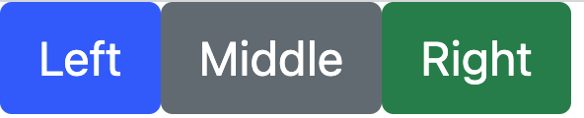
Using components button
export default function MyButton() {
return (
<div>
<Button >Left</Button>
<Button variant="secondary">Middle</Button>
<Button variant="success">Right</Button>
</div>
)
}
Use the variant API to apply complex styles to a component based on a single prop. This can be a handy way to support slight stylistic variations in button or typography components.
Import the variant function and pass variant style objects in your component definition. When defining variants inline, you can use Styled System like syntax to pick up values from your theme

Slide 17
Using Html Button
import 'bootstrap/dist/css/bootstrap.min.css';
export default function MyButton() {
return (
<div>
<button className='btn btn-info' >Left</button>
<button className="btn btn-secondary">Middle</button>
<button className="btn btn-success">Right</button>
</div>
)
}

Slide 18
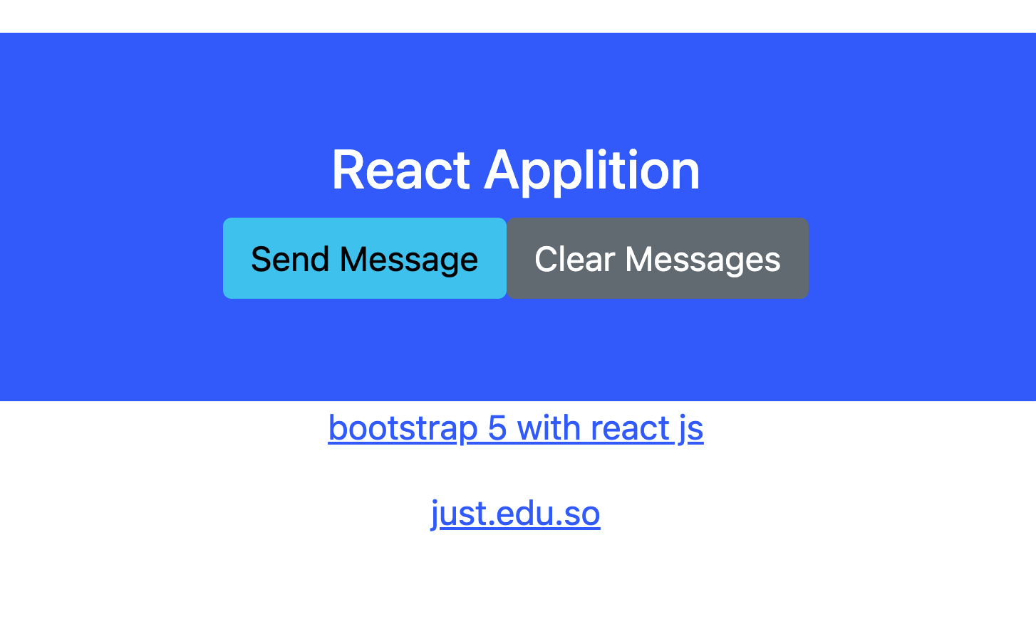
Bootstrap 5 Jumbotron

Slide 19
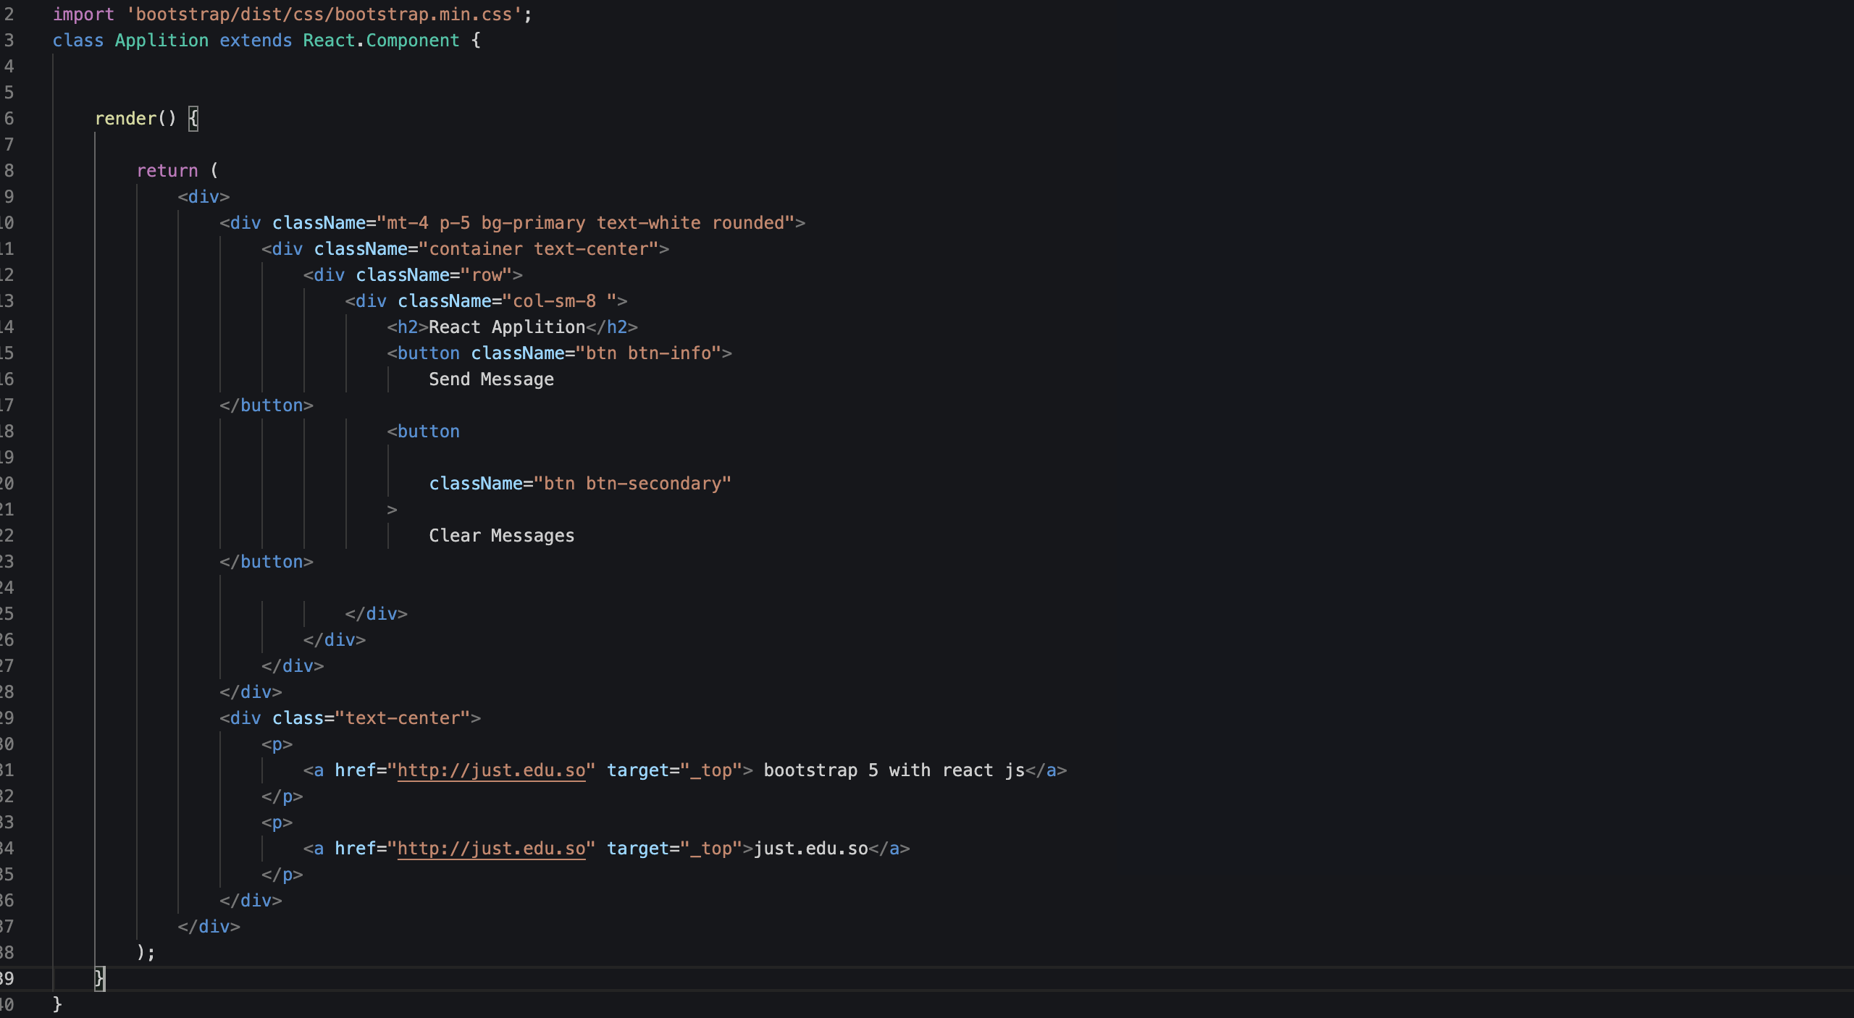

Slide 20
Using Html Button
import 'bootstrap/dist/css/bootstrap.min.css';
export default function MyButton() {
return (
<div>
<button className='btn btn-info' >Left</button>
<button className="btn btn-secondary">Middle</button>
<button className="btn btn-success">Right</button>
</div>
)
}

Slide 21
Bootstrap 5 Cards
A card in Bootstrap 5 is a bordered box with some padding around its content. It includes options for headers, footers, content, colors, etc.
Basic Card
A primary card is created with the .card class, and the content inside the card has a .card-body class
Header and Footer
The .card-header class adds a heading to the card and the .card-footer class adds a footer to the card

Slide 22
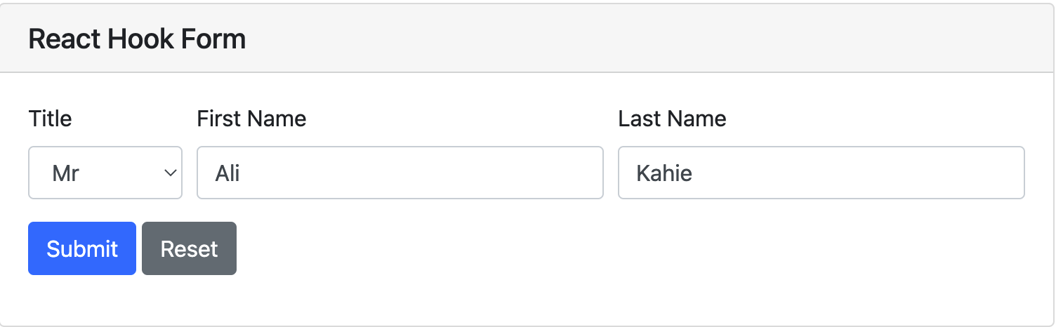
React Hook Form that loads user data into fields
This is an example React Hook Form with a few basic user fields to demonstrate loading data and setting form values after the React component is mounted with a couple of useEffect hooks

Slide 23
React Hook Form that loads user data into fields
This is an example React Hook Form with a few basic user fields to demonstrate loading data and setting form values after the React component is mounted with a couple of useEffect hooks

Slide 24
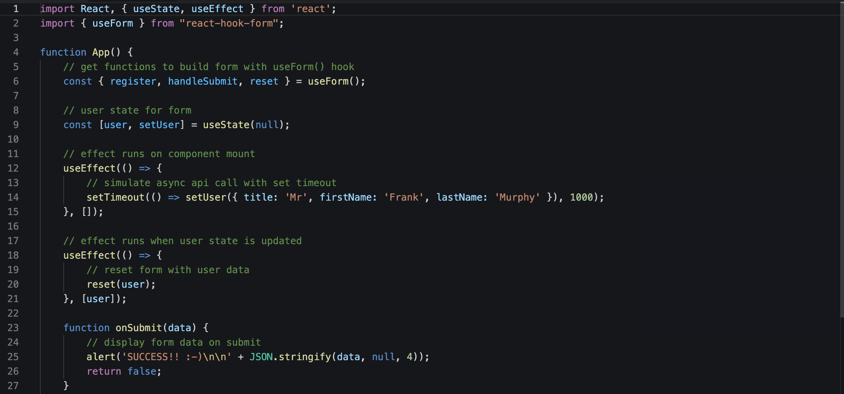
React Hook Form that loads user data into fields

Slide 25
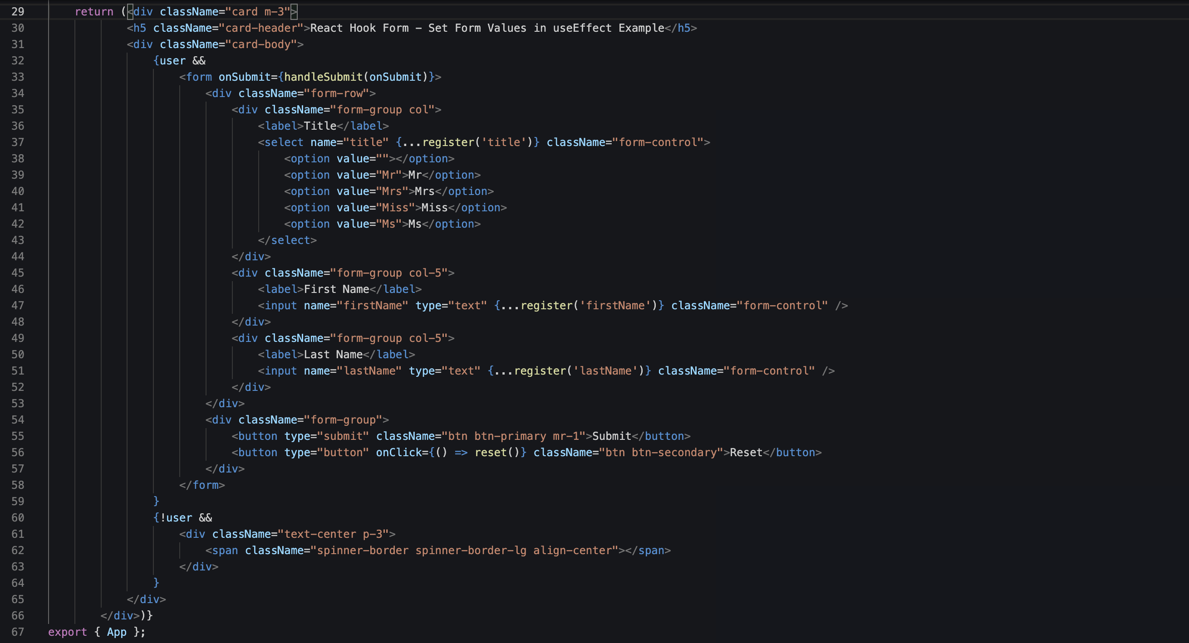

Slide 26
React useReducer Hook
The useReducer Hook is similar to the useState Hook.
It allows for custom state logic.
If you find yourself keeping track of multiple pieces of state that rely on complex logic, useReducer may be useful
Syntax
useReducer(<reducer>, <initialState>)

Slide 27
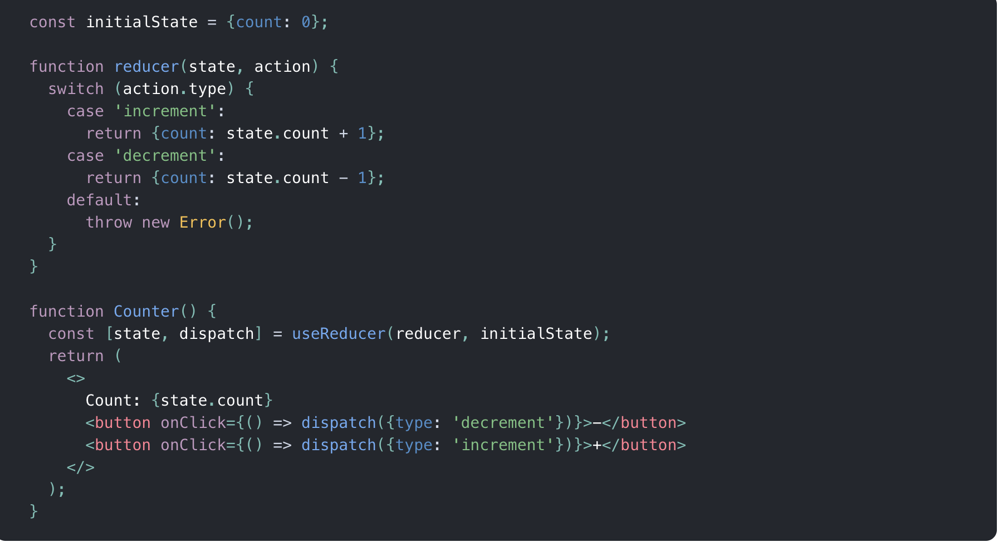
useReducer Hook

Slide 28
React useRef Hook
In general, we want to let React handle all DOM manipulation.
But there are some instances where useRef can be used without causing issues.
In React, we can add a ref attribute to an element to access it directly in the DOM
The useRef Hook can also be used to keep track of previous state values.
This is because we are able to persist useRef values between renders
Notes:
5229920

Slide 29
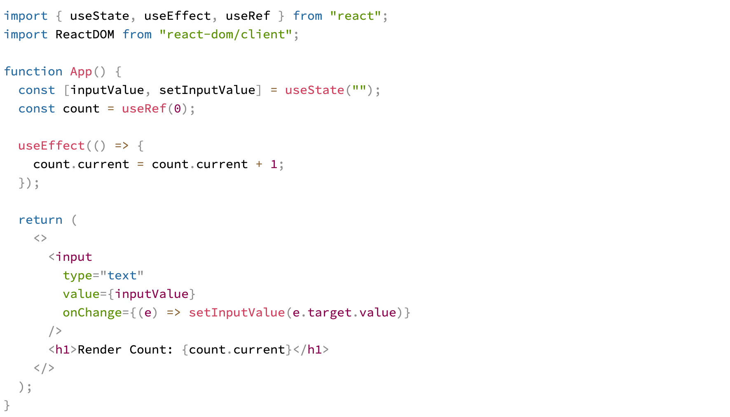
useRef to track application renders

Slide 30
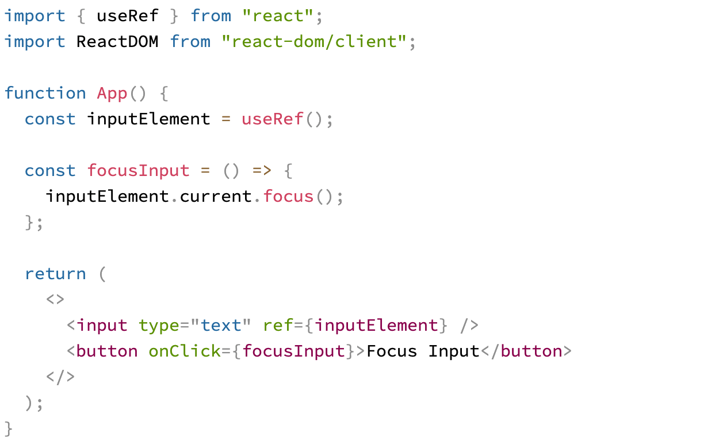
useRef to focus the input

Slide 31
React Router
React Router is a standard library for routing in React. It enables the navigation among views of various components in a React Application, allows changing the browser URL, and keeps the UI in sync with the URL.
In your terminal, use npm to install the package
Notes:
npm install react-router-dom@6

Slide 32
React Router
Router: is the low-level interface that is shared by all router components (like <BrowserRouter> and <StaticRouter>). In terms of React, <Router> is a context provider that supplies routing information to the rest of the app
The <Router basename> prop may be used to make all routes and links in your app relative to a "base" portion of the URL pathname that they all share. This is useful when rendering only a portion of a larger app with React Router or when your app has multiple entry points. Basenames are not case-sensitive
BrowserRouter is the recommended interface for running React Router in a web browser. A <BrowserRouter> stores the current location in the browser's address bar using clean URLs and navigates using the browser's built-in history stack
StaticRouter is used to render a React Router web app in node. Provide the current location via the location prop.
<StaticRouter location> defaults to "/”
Renders the first child <Route> or <Redirect> that matches the location
Switch is unique in that it renders a route exclusively. In contrast, every <Route> that matches the location renders inclusively. Consider these routes
Notes:
npm install react-router-dom@6

Slide 33
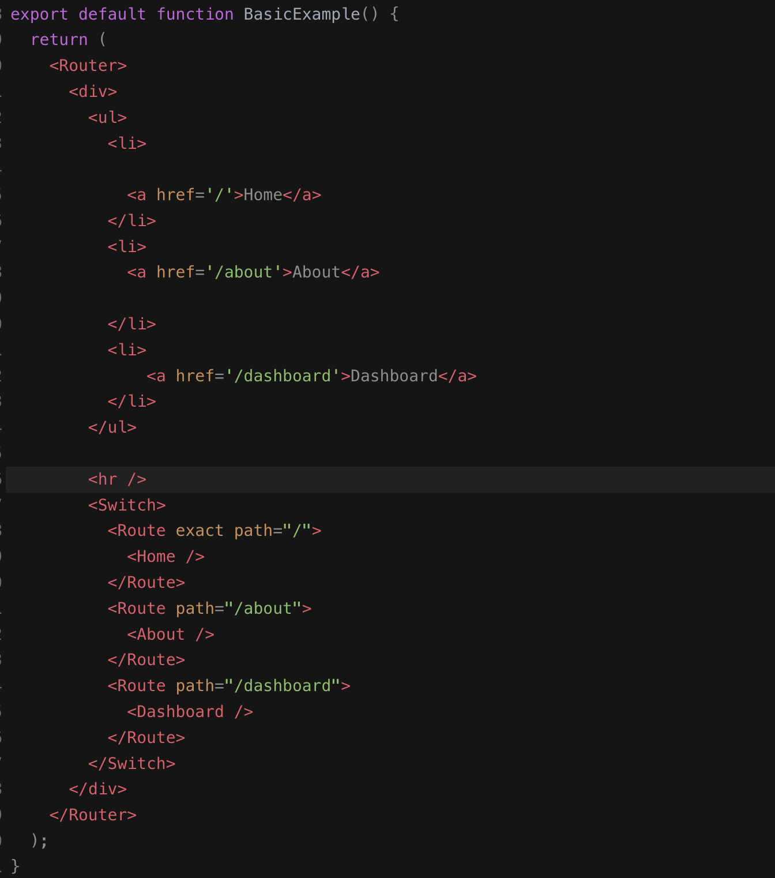
Example

Slide 34
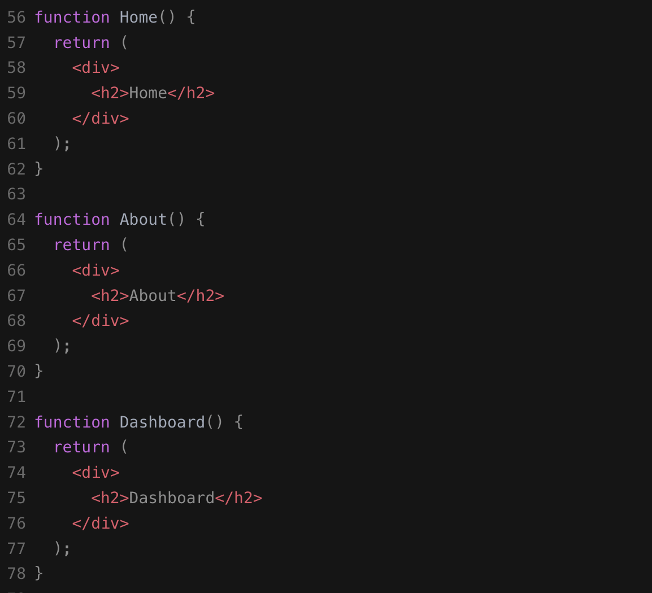
Example

Slide 35
React Router Link
Link Provides declarative, accessible navigation around your application
to: string A string representation of the Link location, created by concatenating the location’s pathname, search, and hash properties
<Link to="/about">About</Link>
Notes:
npm install react-router-dom@6

Slide 36
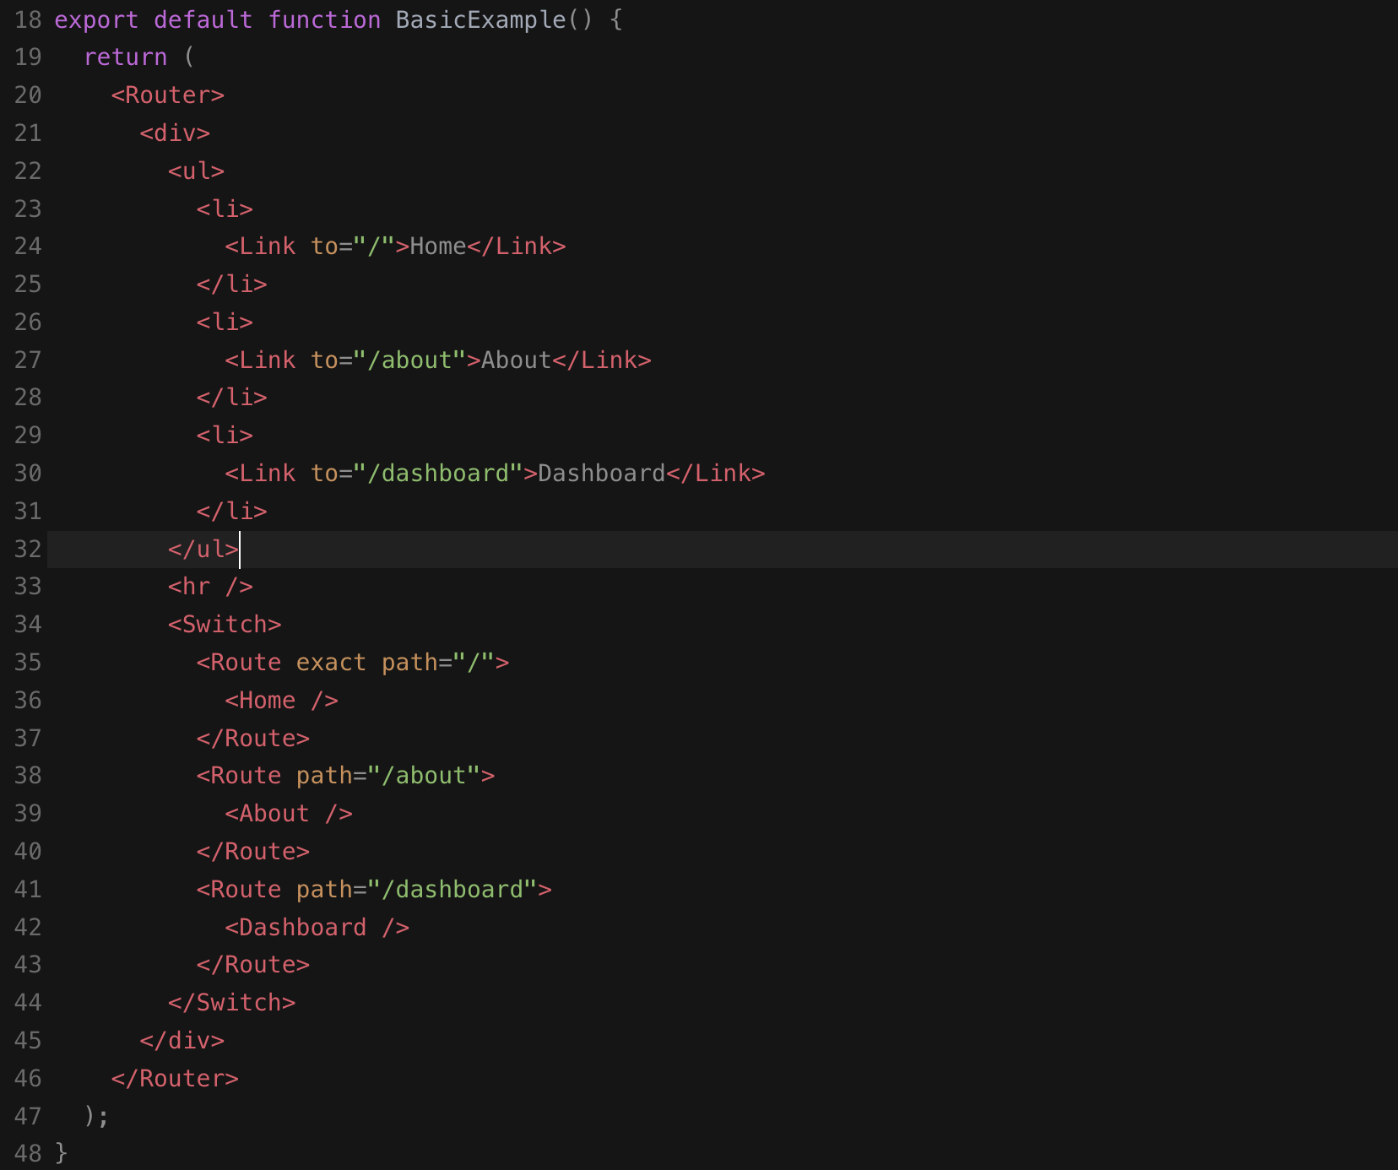
React Router Link

Slide 37
React Router parameters
URL parameters are dynamic (ie. non-constant) segments of a <Route> component’s path prop. They can be used to dynamically serve resources based on the current window location
A URL parameter begins with a colon and is followed by the name of the parameter, like so: :parameter. To specify that a URL parameter is optional, append a question mark, like so: :parameter?
useParams()
React Router’s useParams() hook can be used by a component rendered by a <Route> with a dynamic path to get the names and values of the current URL’s parameters.
This function returns an object containing a key/value pair for each URL parameter where the key is the URL parameter’s name and the value is the parameter’s current value
Notes:
npm install react-router-dom@6

Slide 38
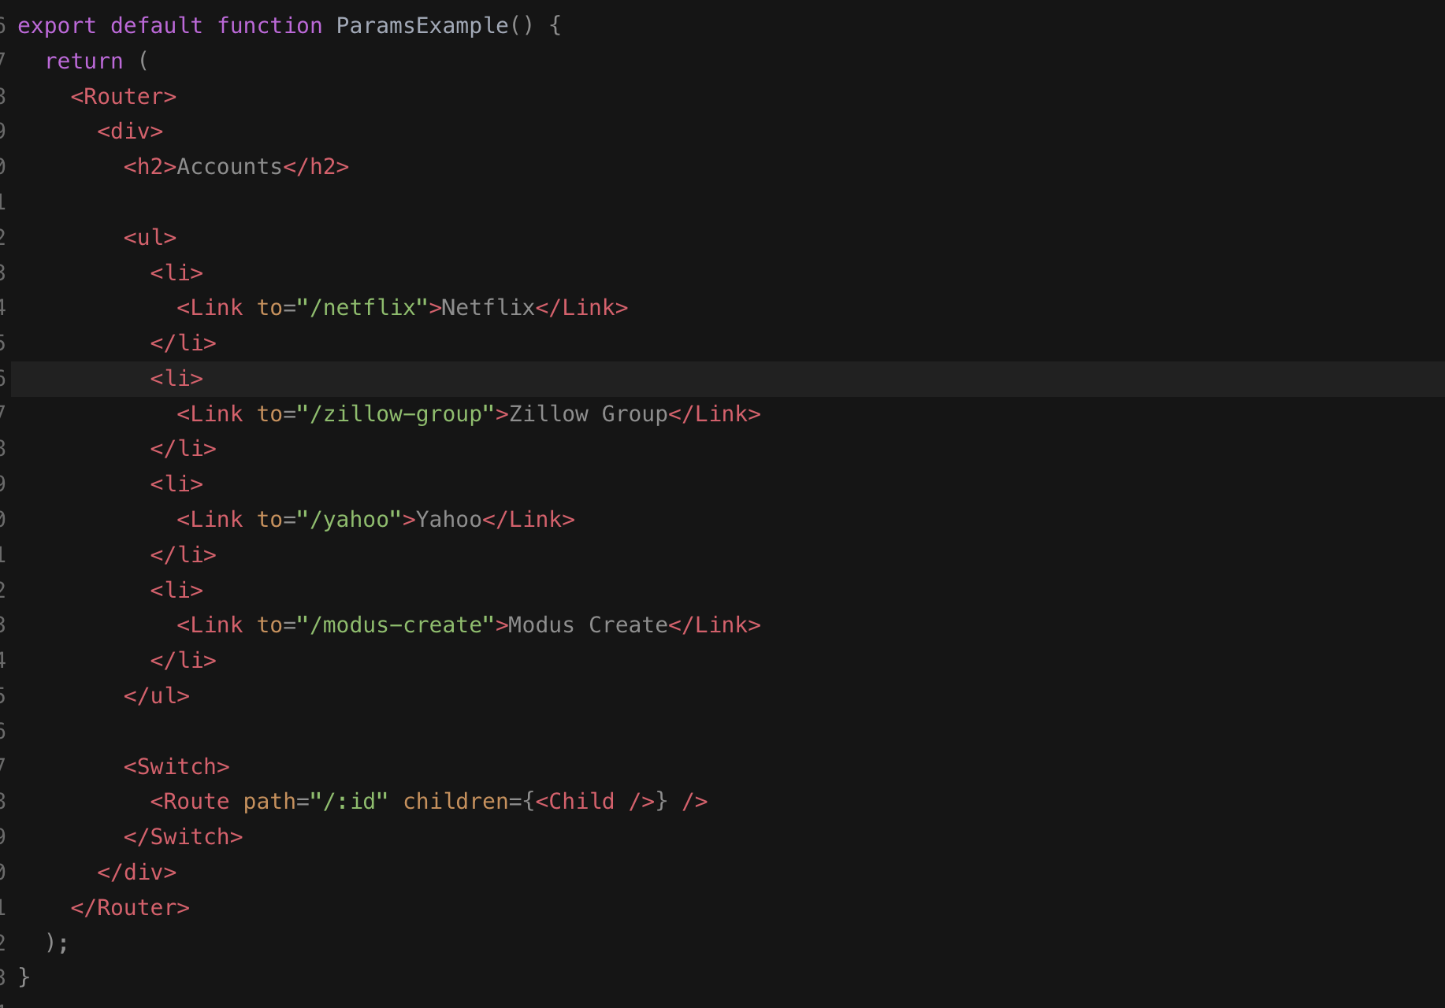
Example Router parameters

Slide 39
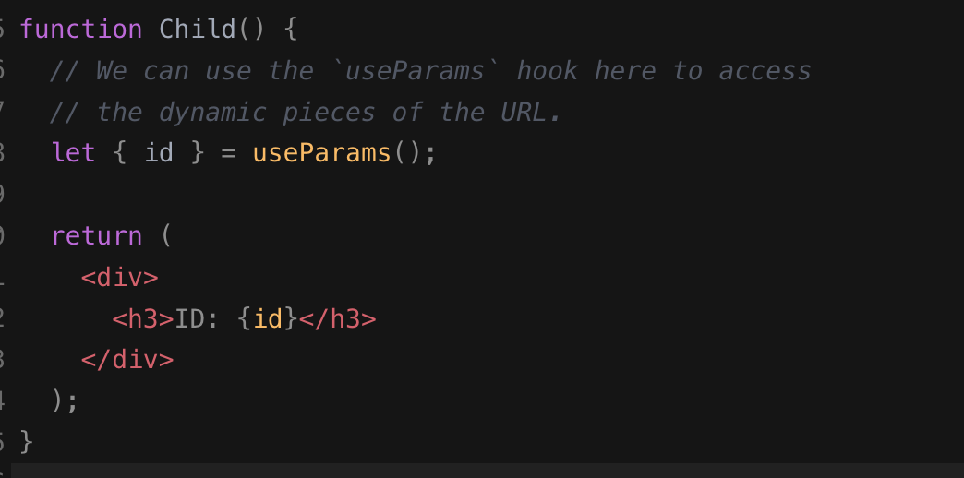
Example Router parameters

Slide 40
How to fetch data with React Hooks
In ReactJS, Axios is a library that serves to create HTTP requests that are present externally. It is evident from the fact that we may sometimes in React applications need to get data from the external source. It is quite difficult to fetch such data so that they can be normally shown on the website
Fetch API data with Axios and display it in a React app with...
Import axios and make a GET request.
Make the GET request when the page renders.
Add the retrieved data to state and pass it to a child component.
Loop through the data in the child component and display it
$ npm install axios

Slide 41
How to fetch data with React Hooks
import axios from 'axios';
function Fetchdata() {
const [data, setData] = useState({ hits: [] }); useEffect(async () => {
const result = await axios(
'https://hn.algolia.com/api/v1/search?query=redux',
);
setData(result.data);
}, []);
return (
<ul>
{data.hits.map(item => (
<li key={item.objectID}>
<a href={item.url}>{item.title}</a>
</li>
))}
</ul>
);
}

Slide 42
useContext
“useContext” hook is used to create common data that can be accessed throughout the component hierarchy without passing the props down manually to each level. Context defined will be available to all the child components without involving “props”.
useContext”, let’s first understand how to make the data available from parent to child components using “props” attributes. We will then introduce the “useContext” hook to the component to understand its impact

Slide 43
useContext
const themes = {
light: {
foreground: "#000000",
background: "#eeeeee"
},
dark: {
foreground: "#ffffff",
background: "#222222"
}
};

Slide 44
useContext
const ThemeContext = React.createContext(themes.dark);
export default function UseContext() {
return (
<ThemeContext.Provider value={themes.light}>
<Toolbar />
</ThemeContext.Provider>
);
}

Slide 45
useContext
function Toolbar() {
return (
<div>
<ThemedButton />
</div>
);
}

Slide 46
useContext
function ThemedButton() {
const theme = useContext(ThemeContext);
return (
<button style={{ background: theme.background, color: theme.foreground }}>
I am styled by theme context!
</button>
);
}

Slide 47
END.

